Slide 1

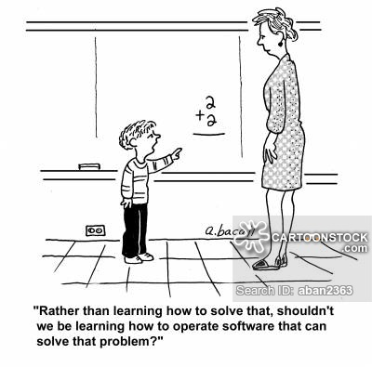

Slide 2
Lecture 5:
Software and Operating Systems
How Computers Do Things You Actually Care About

Slide 3
The Uber Stack
Applications Software
Middleware
Operating Systems
Computers
Processors | Memories | Display Components | Interconnects
Materials
Physics
Notes:
Fed from developments in lowest and highest levels
Even if you don’t remember the past, you are condemned to repeat it…
What is the cycle time?

Slide 4
Remember, how we Interact with Computers
Applications
User
Operating System
Hardware

Slide 5
Base 2 (Binary) vs. Decimal Comparison
10⁵ 10⁴ 10³ 10² 10¹ 10⁰
10^{n} = 100,000 10,000 1000 100 10 1
2⁷ 2⁶ 2⁵ 2⁴ 2³ 2² 2¹ 2⁰
2⁷ = 128 64 32 16 8 4 2 1

Slide 6
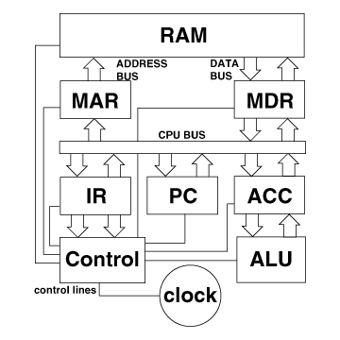
Remember our CPU is at the core
Fetch,
Decodes,
Executes Instructions
in sequence

Slide 7
What is Software?
Software = Programs
Programs = a set of computer instructions for carrying out computing tasks
Programmer = He or She that attempts to correctly structure those instructions to achieve a desired result

Slide 8
Computer Programmers; a definition
“Their rumpled clothes, their unwashed and unshaven faces, and their uncombed hair all testify that they are oblivious to their bodies and to the world in which they move. These are computer bums, compulsive programmers.”

Slide 9
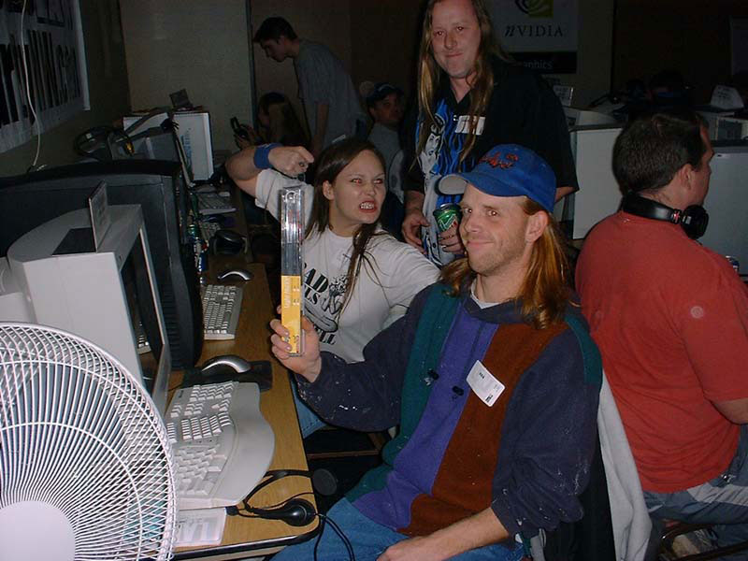
Programmers having fun at work
“The trouble with programmers is that you can never tell what they are doing until it’s too late.”

Slide 10
Programming Language
A programming language is a convenient way of expressing instructions for a computer to execute
Computer languages have evolved to the point where anyone can learn the basics of using one

Slide 11
Low and High Level Languages
Programming languages are divided up into low-level languages and high-level languages.
The closer the language is to machine language, the lower the level.
High level languages make it much easier to develop large complex programs.

Slide 12
Machine Language
Every computer CPU has its machine language, the set of instructions it knows how to execute. This is the lowest level.
A typical instruction might say, get the contents of a certain memory location and put it in the accumulator register (perhaps in preparation for adding it to another number).

Slide 13
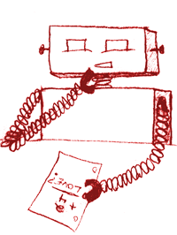
Natural Languages
Computers don’t understand English
Need to deal with
  Ambiguity
  Redundancy
  Literalness
So, we express what a computer should do in a formal language

Slide 14
A Machine Language Program
Put contents of memory location 10 in accumulator.
Add contents of memory location 11 to accumulator.
Put contents of accumulator back in location 10
It might look like
110011011111100111110000011110000010000011111
100010001000100100001000001111000001110000000
010000100010010000101010000111001110000011000
…..not very user friendly! But believe it or not, computers were programmed by humans in machine language at one time.

Slide 15
Assembly Language
(one level up from machine code)
Assembly language is machine language made slightly easier.
LDACC 0A ; (current_balance)
ADD 0B ; (add new_check) Add Value in location 0B
STACC 0A ; (store new_balance)
Load ACCumulator
Store ACCumulator

Slide 16
High-Level Languages
In a high-level language the previous piece of code might look like this:
Input current_balance
current_balance = current_balance +new_check;
store current_balance

Slide 17
Compilers and Interpreters
A compiler is a program than turns a high-level language program into a machine-language program. (Then when one wants, once can execute the machine-language version.)
An interpreter is a program that executes the high-level program directly and translates it into machine language on the fly.

Slide 18
Some High Level Languages in Use Today
Fortran
Basic
PL/1
Cobol
C
C++
VISUAL BASIC
Pascal
LISP
ADA
JAVA
PHP
Python
Javascript

Slide 19
Interpreters vs. Compilers
Interpreters are easier to write than compilers.
Interpreter languages allow immediate editing and execution without the intermediate step of compiling.
Compiled code runs faster than interpreted code however so it is preferred in performance sensitive applications.
But this is slowly changing…..Why?

Slide 20
Software Creation Process
Problem specification
Pseudocoding (or flowcharting)
Coding
Testing and debugging

Slide 21
Writing Software, the right way
Planning 10%
Design 30%
More Design 20%
Coding 20%
Testing 20%
Release for use

Slide 22
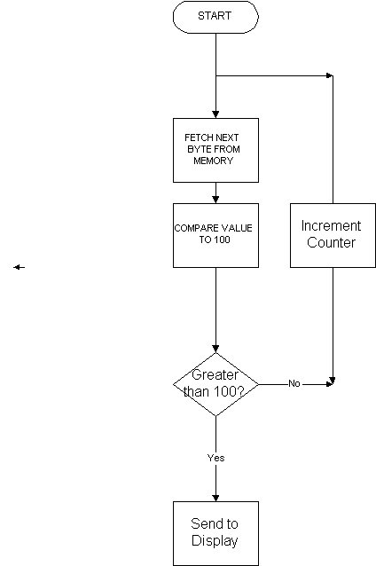
Page 1 of 1
Flowcharting a design

Slide 23
Pseudo Code(ing)
Allows you to write a program in english for the purpose of design without having to worry about specific computer language syntax and allows the programmer to concentrate on the logical sequences
  Start
    Input (amount)
    Amount = amount*4.33
    If amount < 58 then print “It’s less than 58”
    Otherwise print “It’s over 58”
    End

Slide 24
Python!
Python is a great language for learning basic elements of programming
Easy to understand syntax
Runs in an Interpreter for instant results!
Available for free at www.python.org
Runs on practically any computer!
We will use Python later in the course

Slide 25
A Typical Real world problem
A real-world example is assigning gates at airports. Some constraints are:
A plane that lands at time t1 should be assigned a gate for use at time t2 > t1.
If a plane is at a gate, no other plane may be assigned that gate, etc.
Find an assignment of gates that minimizes passenger time (and perhaps distance).

Slide 26
    Millionaire Quiz!!!!

Slide 27

Complexity
Controlling complexity is the essence of computer programming
-Brian Kernigan
Controlling Complexity !!!!
Con

Slide 28
The Price of Failure
The opening of the new Denver Airport was delayed for almost one year in 1994!
  The software which handled the routing of luggage from the gates to the various luggage carousels was so complex that it could not be fixed in time for the opening and the airport was two large to operate without it
  The delay in opening cost over $1Million per day!

Slide 29
Quoted from the morning news
The morning news reported that the opening of Denver's new international airport would be delayed indefinitely until problems with the automated baggage handling system are fixed.
While the video showed the machinery shredding open suitcases and throwing clothing all over the floor, the voice over of the airport director stated, "We think it's mostly a software problem."
Today's

Slide 30
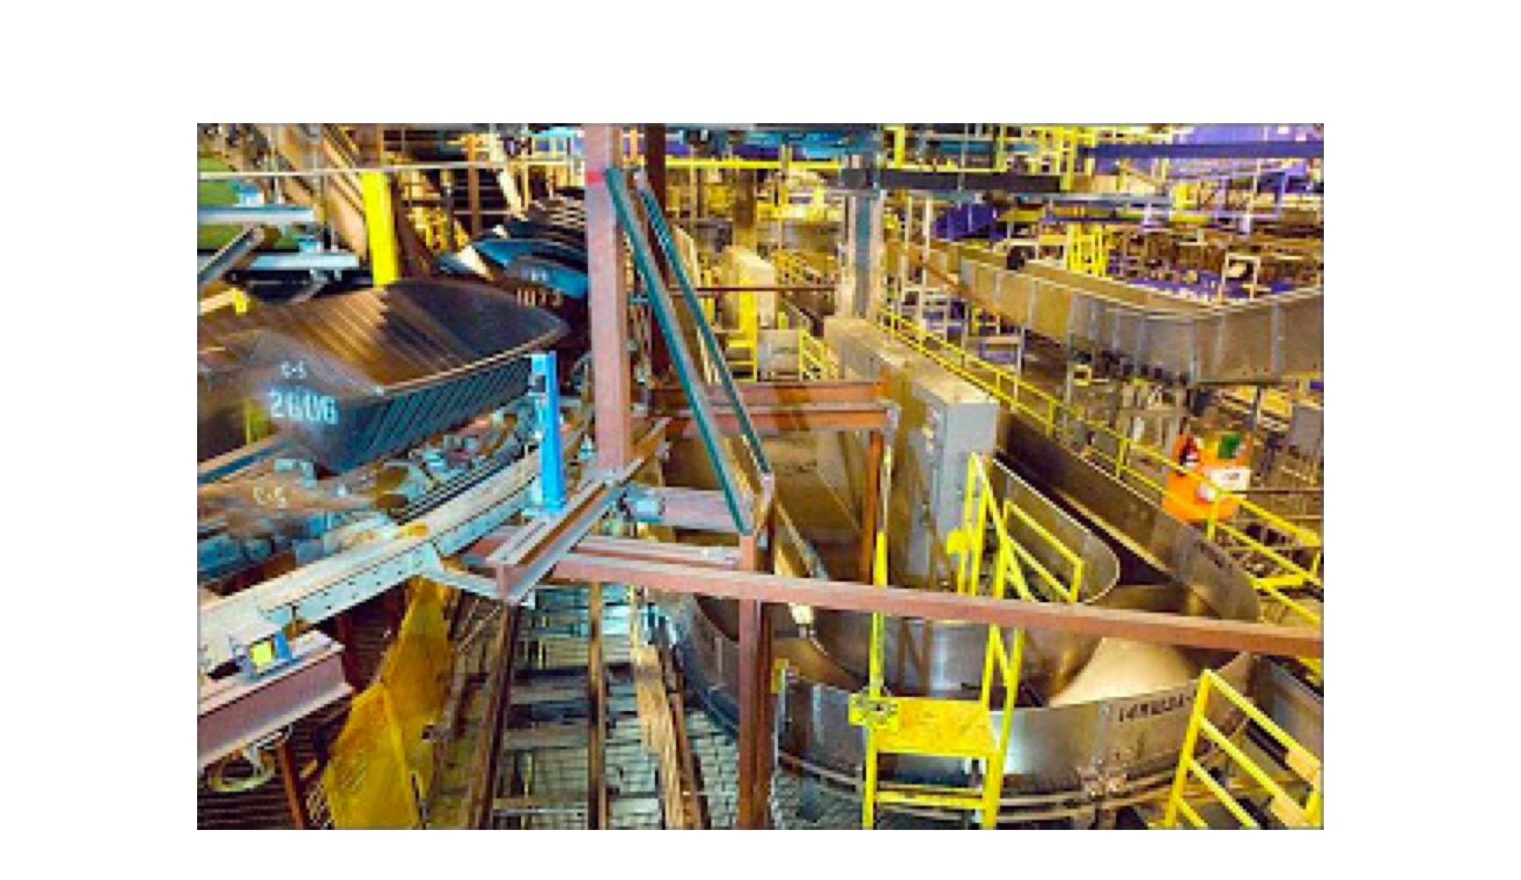
Even 120 Computers couldn’t figure this out!
A small portion of the Denver Conveyer System

Slide 31
Complexity
Software is becoming more complex as we attempt to solve more complex and difficult problems
Managing complexity is a huge problem in software reliability and cost
The problem is getting worse, not better as reflected in industry software issues worldwide

Slide 32
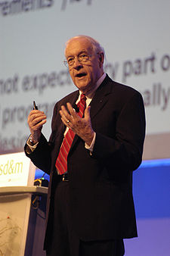
Cases in Complexity
Fred Brooks : Former IBM 360 Development Mgr
Wrote the famous “The Mythical Man Month” about the trials and tribulations of writing the Operating System for the IBM 360 in the 1960’s, at that time the most ambitious software project ever undertaken
Brook’s Law - Adding more people to a late software project only makes it later.

Slide 33
Some case studies in software disasters
http://www.intertech.com/Blog/15-worst-computer-software-blunders/
“To err is human, but to really foul things up you need a computer.” –Paul Ehrlich

Slide 34
So, Speaking of Complexity

Slide 35
Operating Systems:
Software That Runs the Show
Making everyone’s life a little easier….?

Slide 36
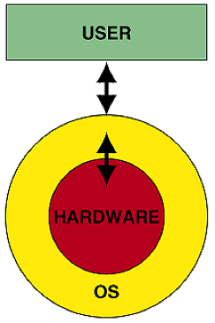
Operating System
The OS is a collection of resident programs that
  manage the system’s resources
  supervise the execution of processes
  provide useful services known as Utilities

Slide 37
OS Components
An operating system is a collection of programs that perform the following tasks:
Managing user requests (Supervisor)
Interpreting user commands (User Interfaces)
I/O control
Memory management
File management
Execution-Monitoring
Security
Multitasking

Slide 38
System Calls
The work of the OS comes about through system calls to one of the OS components.
The system calls are initiated either by the user (e.g., by a mouse click) or by the user application software.
For instance, saving a file to a directory location.

Slide 39
User Interface
Most computer users used to interact with the OS by clicking on icons with the mouse.
Some operating systems (e.g., Unix or Dos) typically use text-based interfaces. E.g.,
prompt
C:\ edit cs2
C:\ cd ipstack
C\ipstack> ipconfig
command
prompt

Slide 40
The User Interface
  Text-based Command Line Interpreters (CLIs)
    terse, powerful
    steeper learning curves, unforgiving
  Graphical User Interfaces (GUIs)
    intuitive, user-friendly
    slower, less efficient

Slide 41
The User Interface sets the Tone
PCs universally used text based command line interfaces until 1983
Then, Apple, using research from Xerox Parc, introduced the Lisa, followed quickly by the Macintosh which changed everything
WYSIWYG comes alive !!
Arcane commands are OUT! …GUIs are IN !!
Microsoft introduces Windows in ‘84

Slide 42
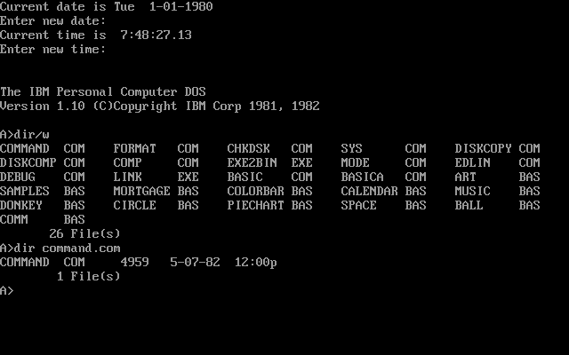
A Typical Command Line Interface

Slide 43
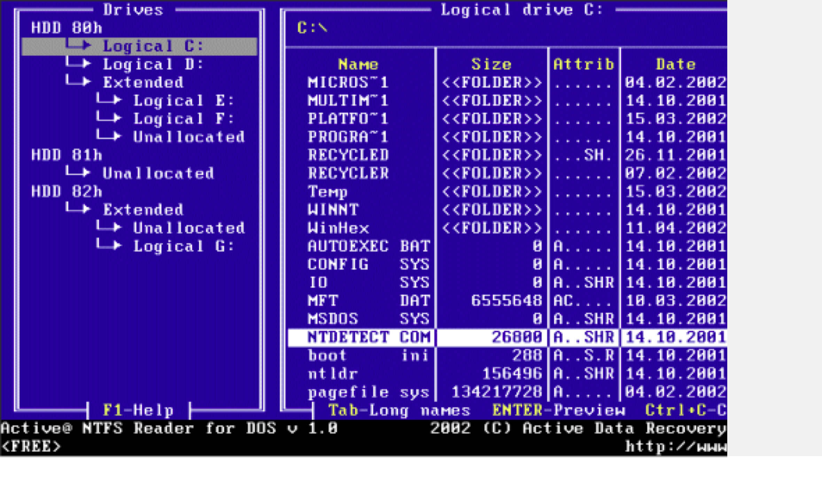

Slide 44
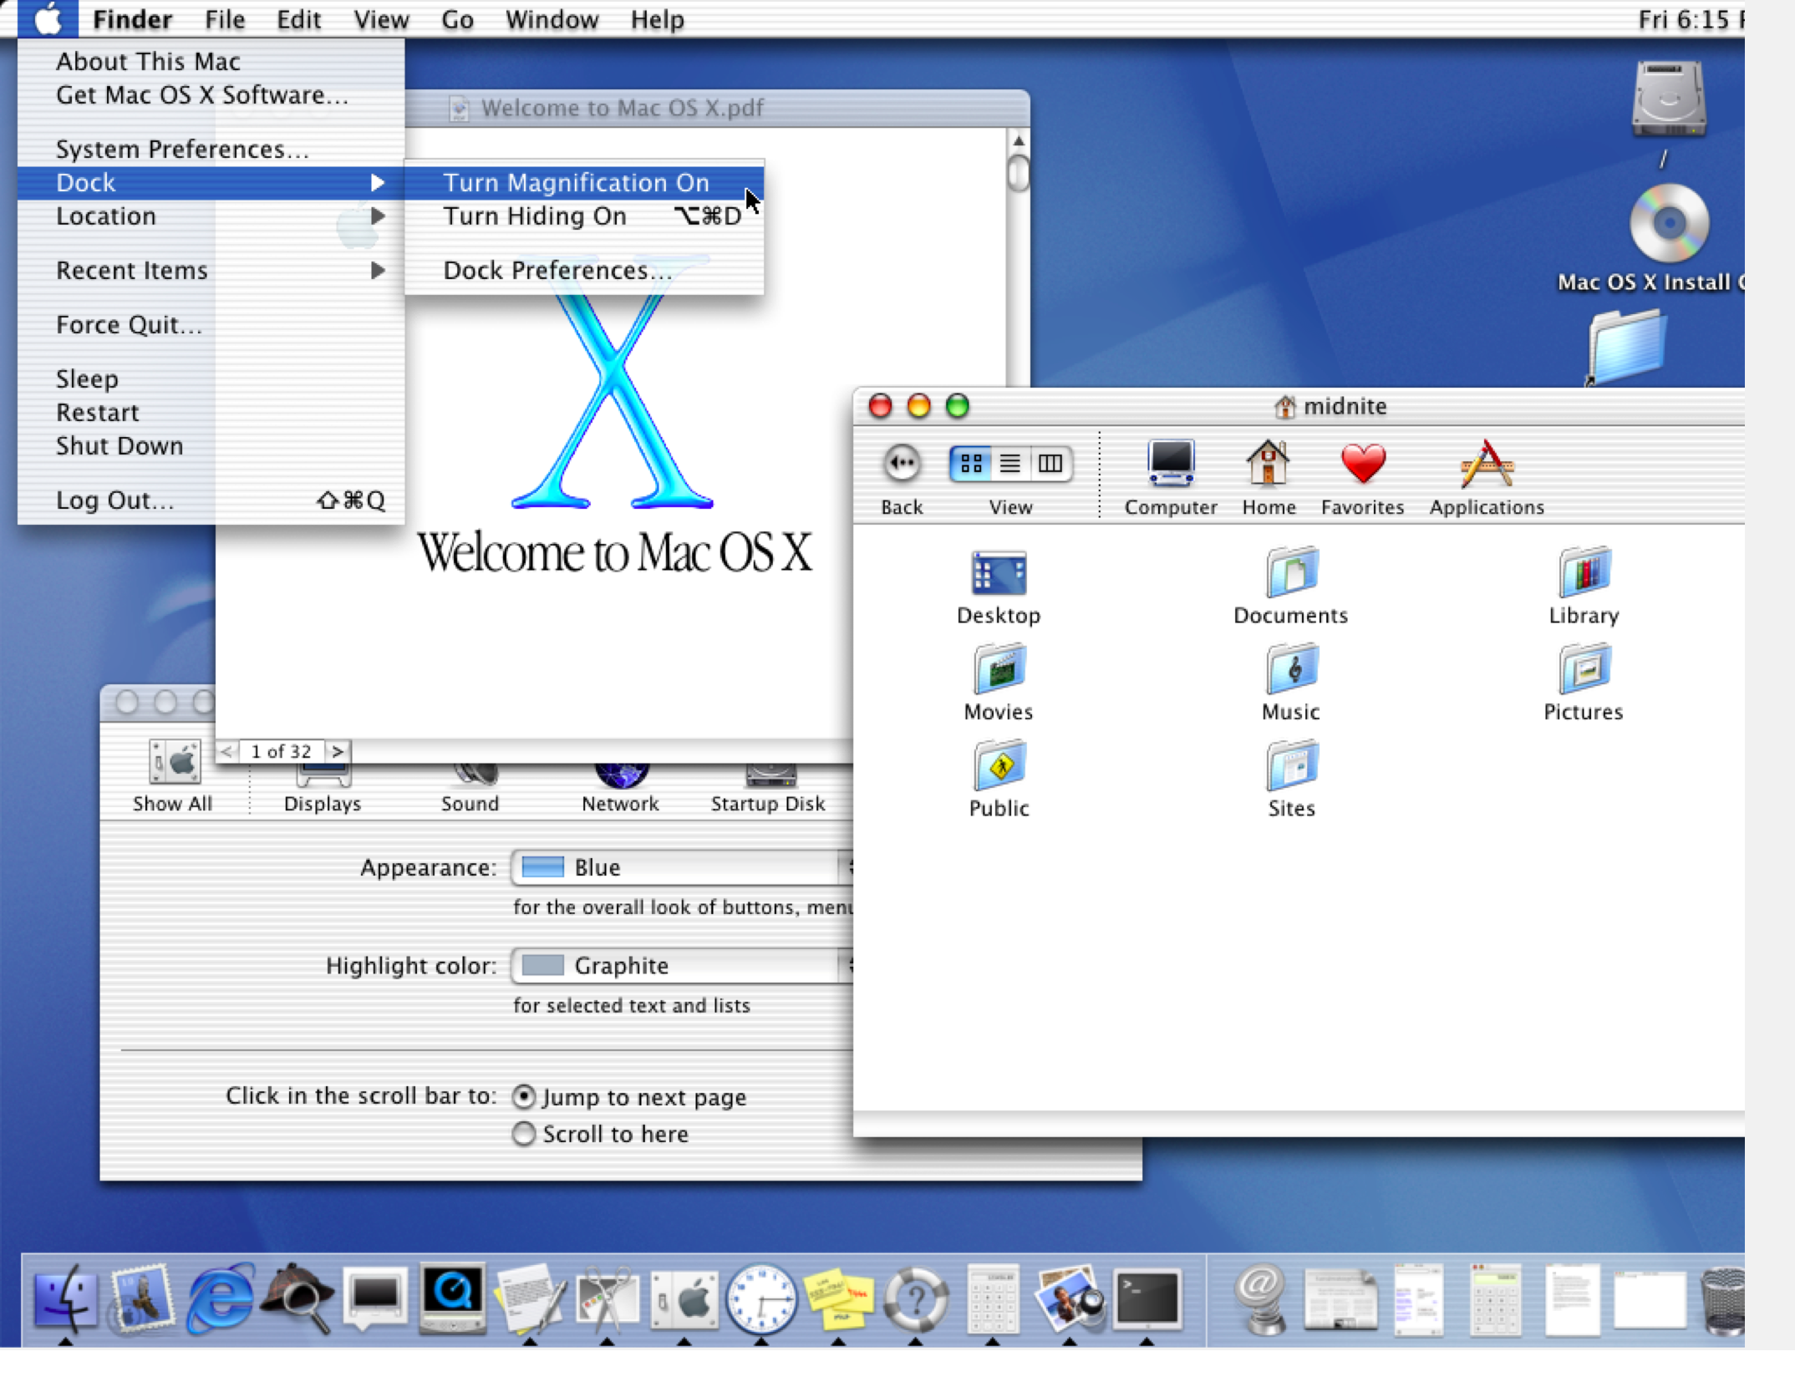
Contrasted with this…

Slide 45
File Management
Files are collections of data arranged in a specified format for use by programs
Files can reside in memory as well as in peripheral devices such as disk drives, CD-ROMs or tape drives
Every file has a name and attributes that specify its size, its location and its type

Slide 46
File Manager
Creating and maintaining references to a system’s files is the responsibility of the file manager.
The actual address of a file is a pathname, which is made up of the folders in which the file is located (sometimes called directories) and the file name.

Slide 47
Directories and Pathnames
C:\Hobbies\
C:\CS2\Lec1.ppt
Hard Disk C:
CS2
Research
Hobbies
Lec1.ppt
Theater
Art
Reading
Lec1.doc

Slide 48
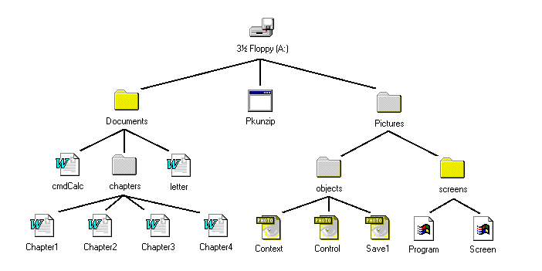
The File Manager maintains the hierarchy between the physical and logical

Slide 49
The File Manager Keeps Track of File Types
It is important to know what type of data is stored in any given set of locations
Types include PROGRAM INSTRUCTIONS, TEXT, IMAGES, VIDEO, SOUND as well as numerical data such as INTEGERS and Real NUMBERS
The file manager keeps track of the different types of data and its location

Slide 50
Input/Output (I/O) Drivers
An I/O driver is a special program that knows how to communicate with a peripheral device and the CPU
To read or write a file to a disk the file manager determines the name and location of the file, and control is passed to the disk’s I/O driver, which will send commands to the disk arm, read head, etc.

Slide 51
The Memory Manager
When we click on a Word document, the OS must bring first the Word program into RAM, and then the particular document we wish to work on.
Allocating segments of RAM to each program is the responsibility of the memory manager.

Slide 52
Execution Monitor
If an error occurs in the course of running a program, control is passed to the execution monitor.
The execution monitor is responsible for ensuring that an error caused by a program does not cause the entire system to crash.

Slide 53
Multitasking
While most modern computers can only execute one operation at a time, it is often useful to give users the illusion that several things are going on at the same time
This ability is called multitasking
This is most apparent if several users are sharing the same computer, but it is also useful for single user computers that are running multiple programs

Slide 54
Components of Multitasking
Context switching--going from one process to another (like printing one file while working on another), since I/O is so much slower than internal computation –the OS interrupts the current process; stores information for resuming that process; loads and commences the next ready (waiting) process
CPU Scheduling--deciding which process to work on next.
Virtual memory-- needed when there are multiple programs running, it allows the machine to behave as if all the programs were in RAM at the same time. It accomplishes this by using the disk to act like temporary RAM…this is called a RAMDISK

Slide 55
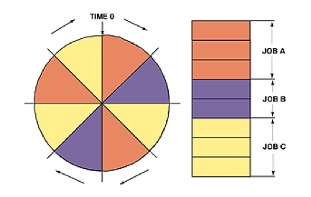
CPU Task Scheduling
CPU SCHEDULER–determines the order for ready and waiting processes
example:
ROUND
ROBIN method

Slide 56
Security
The OS provides some basic security features
Password access
Firewall to block unwanted access from the Internet
Monitors your virus control programs
Monitors the integrity of your files
Generally insufficient, which requires additional security software to be added to the system

Slide 57
Questions ?

