Slide 1
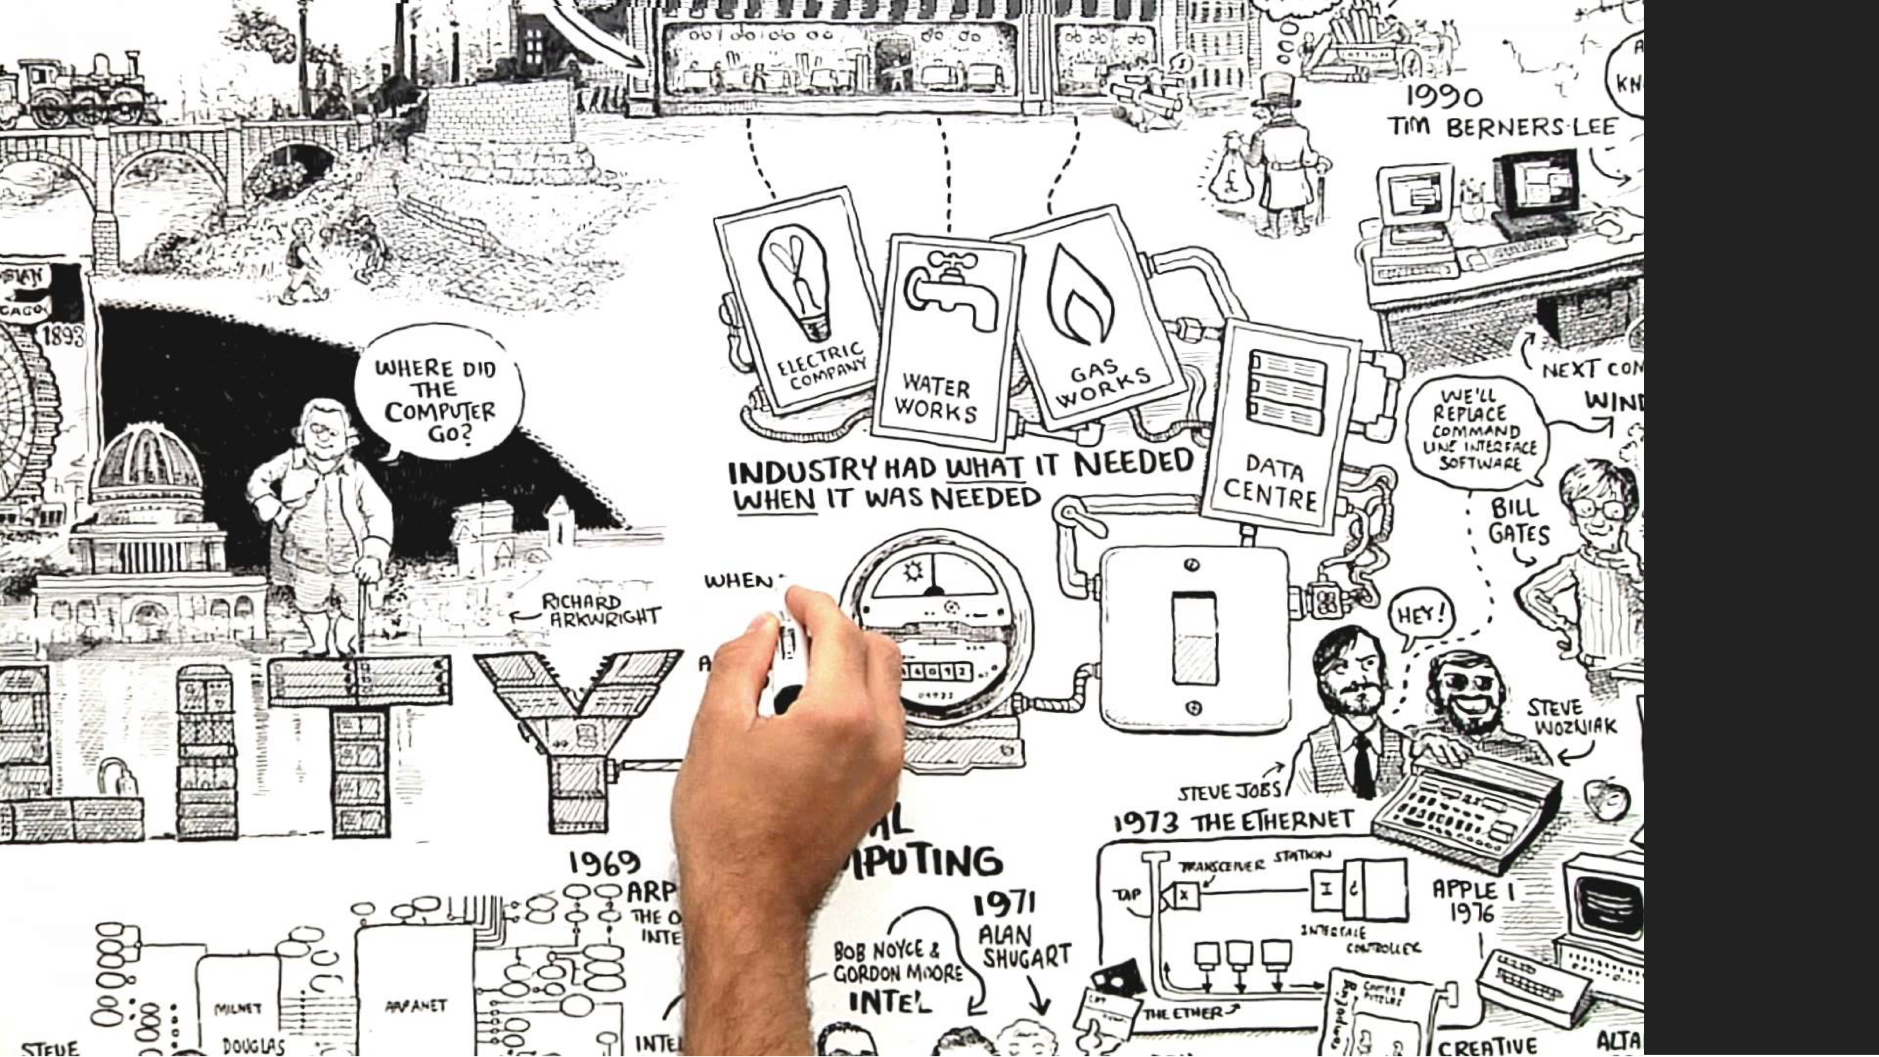
Lecture 2 : A Short History of Computing

Slide 2
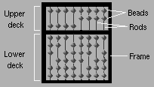
The Origins of Digital Computers
earliest computing devices designed to aid numeric computation
abacus, first developed in Babylonia over 5,000 years ago
still in use today!

Slide 3
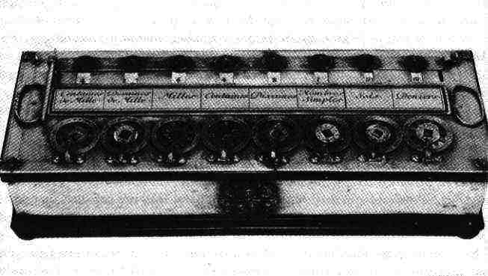
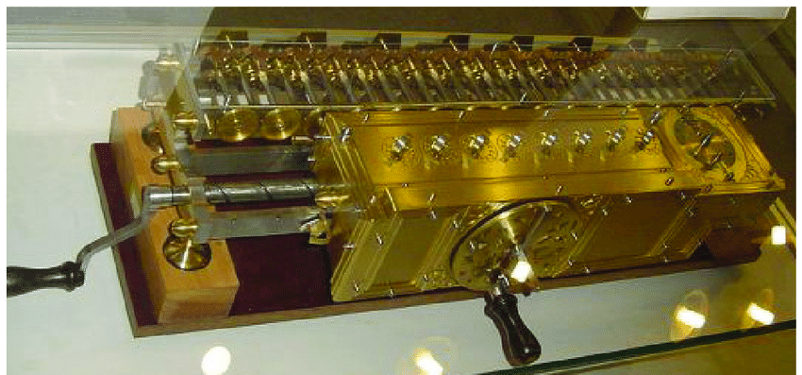
Early Calculating Machines
William Schickard (1592–1635), mechanical calculator
Blaise Pascal (1623–1662), addition and subtraction decimal calculator
G. W. F. Leibniz (1646–1716), “Stepped Reckoner,” full-featured calculator,
(“Leibniz wheel” for multiplication / division)
Pascaline
Stepped Reckoner Machine

Slide 4
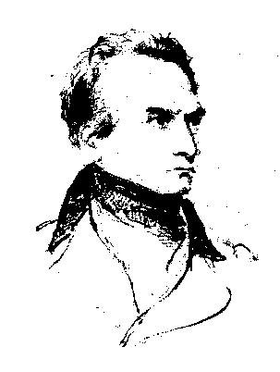
Charles Babbage (1791–1871)
First true pioneer of modern computing machines
Designed two prototype calculating machines neither of which was practical to build at the time
Difference Engine
Analytical Engine

Slide 5
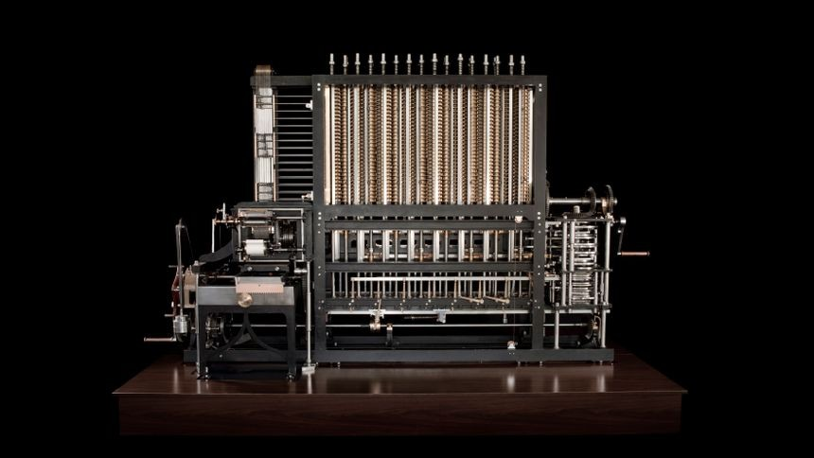
The Difference Machine

Slide 6
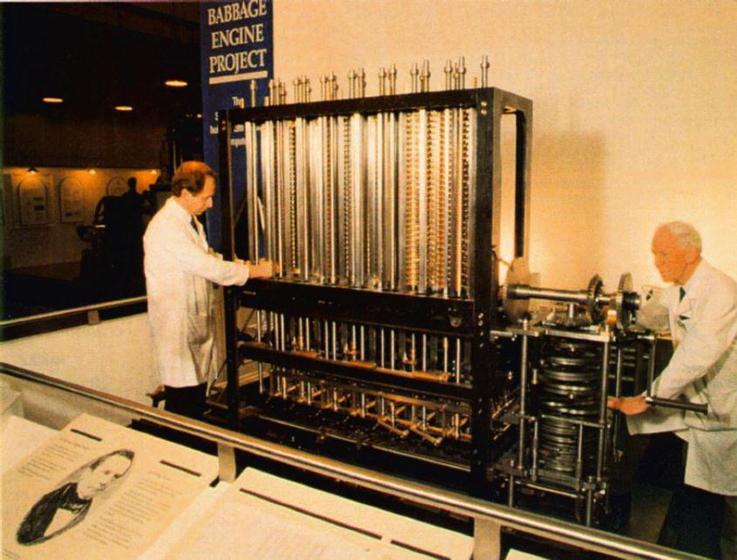
Babbage’s Difference Engine
Special purpose calculating machine
automated both the computation of tables and their printing
employed the method of differences to calculate polynomials

Slide 7
Legacy of Babbage
Designed the first, general-purpose digital computing device
Unfortunately his ideas and achievements were lost on his successors
The first complete Difference Engine was completed in London in 2002, faithfully to the original drawings, consists of 8,000 parts, weighs five tons and is 11 feet long
In Babbage’s time it would have requires a steam engine to power it!

Slide 8
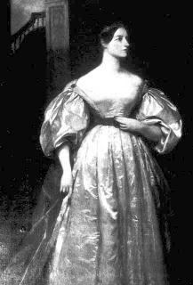
World’s First Programmer
Ada King, daughter of Lord Byron wrote the “programs” for the Difference Engine,
She also adds a step-by-step description for computation of Bernoulli numbers with Babbage's machine — basically an algorithm — which, in effect, makes her the world's first computer programmer….ever

Slide 9
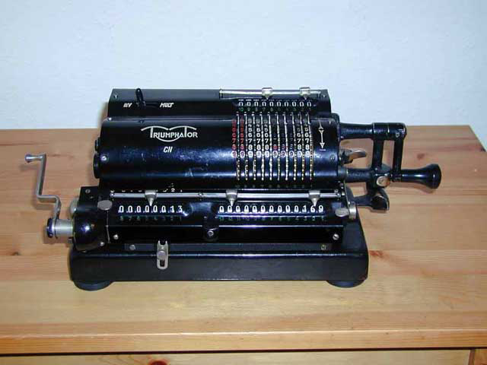
1880-1901 The Birth of the Modern Mechanical Calculator

Slide 10
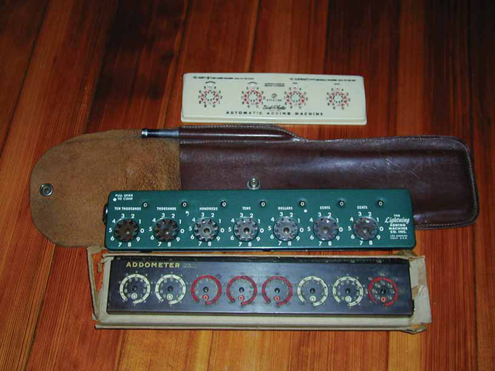
Early Pocket Calculators

Slide 11
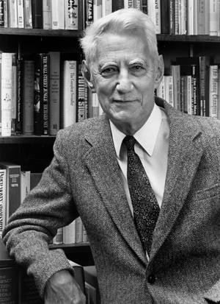
Claude Shannon 1916-2001
Bell Laboratories
In 1937 , Claude Shannon introduces the concept of binary logic for use in creating digital computing machines
In 1948 he publishes “A mathematical theory of communication” which sets forth the principals for encoding information so that it might be computed and transmitted electronically
Considered by many the equivalent of Einstein’s theory of General Relativity
He is affectionately thought of as the Father of the modern information age

Slide 12
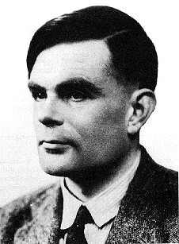
Alan M. Turing (1912–1954)
led the WWII research group that broke the code for the Enigma machine
proposed a simple abstract universal machine model for defining computability
devised the “Turing hypothesis” for Artificial Intelligence
See the movie “The Imitation Game”

Slide 13
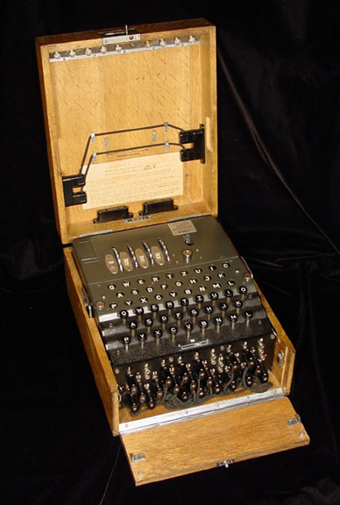
The Enigma Machine
Invented in 1918, it was the most sophisticated code system of its day, and was a priority of the Allies to decipher so that they could keep supply convoys out of the path of German submarines (U-boats)
Breaking the code was pivotal in allowing the allies to know where the Germans believed the D-Day invasion would occur
“Saved 14 million lives and shortened war by 2 years”

Slide 14
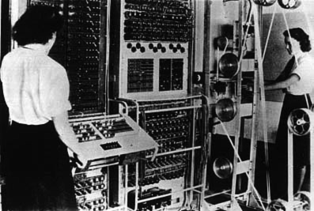
Alan Turing and the Colossus
A second generation electronic computing machine (1943) used to decrypt German enigma coded messages (arguably the first real digital computer)
Featured in the recent movie “The Imitation Game”

Slide 15
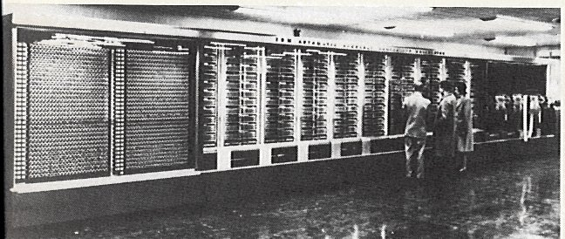
IBM Harvard Mark I- 1944
The IBM Automatic Sequence Controlled Calculator after installation at Harvard University, 1944. It is 51 feet long, weighs 5 tons, and incorporates 750,000 parts.

Slide 16
Mauchly and Eckert
John W. Mauchly (1907–1980) and J. Presper Eckert (1919– ) headed the ENIAC team at the Moore School of Engineering, University of Pennsylvannia
ENIAC (Electronic Numerical Integrator And Computer) was the first electronic “general purpose” digital computer
Commissioned by the Army for computing ballistic firing tables

Slide 17
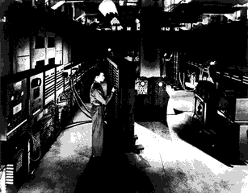
ENIAC
noted for massive scale and redundant design
decimal internal coding
operational in 1946

Slide 18
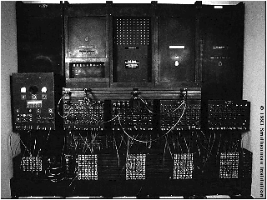
ENIAC
  manual programming of boards, switches, and a“function table”

Slide 19
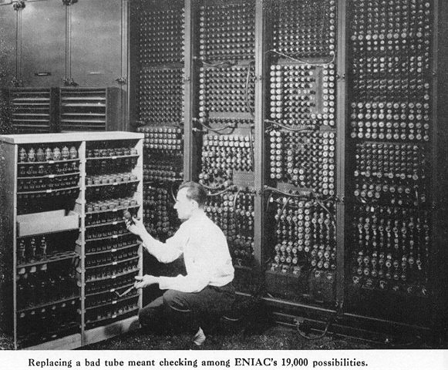

Slide 20
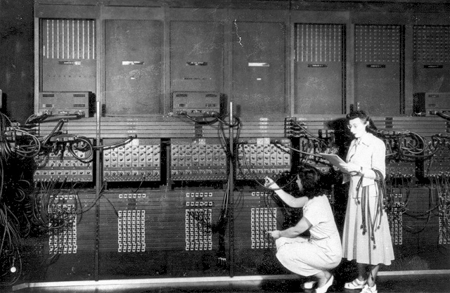
Early Computer Programming was slow, tedious and repetitious

Slide 21
John Von Neumann (1903–1954)
Von Neumann visits the Moore School in 1944
prepares a draft for an automatic programmable device (later called EDVAC)
“stored program” concept
publishes ideas (with Goldstine and Burks) in 1946
designed the IAS (Institute for Advanced Studies) machine which became operational in 1951

Slide 22
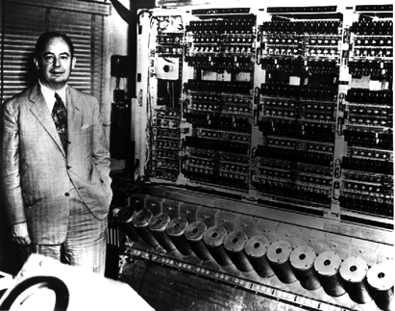
Von Neumann Architecture
“stored program”
serial uniprocessor
design
binary internal
encoding
CPU–Memory–I/O orgranization
“fetch-decode-
execute” instruction cycle

Slide 23
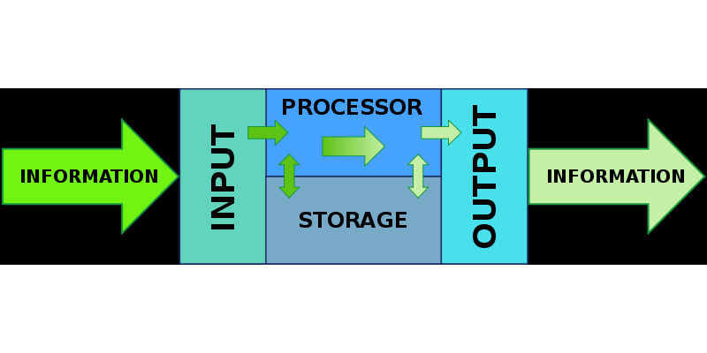
Basic von Neumann architecture

Slide 24

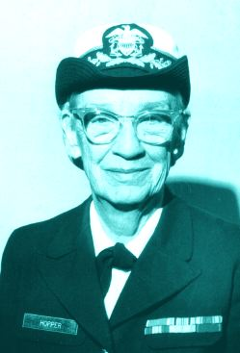
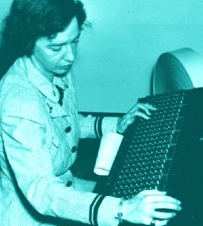
Contents | Next
Contents | Next
The First real “Computer Scientist” 1906-1992
Invented the first Compiler because she was tired of generating machine code by hand. Vastly improved programming speed and efficiency

Slide 25
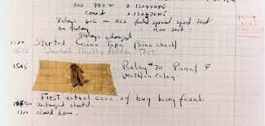
Grace Hopper’s Notebook with incinerated Moth taped into the log. The “FIRST” real Computer BUG!

Slide 26
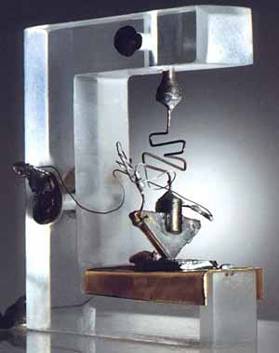
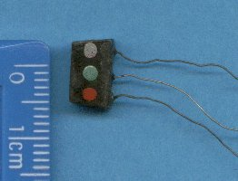
Early Bell Labs Transistor 1947 / 1952
“The most important invention of the 20th century…”

Slide 27
?
What was the first practical consumer device that resulted from this miraculous new technology?

Slide 28
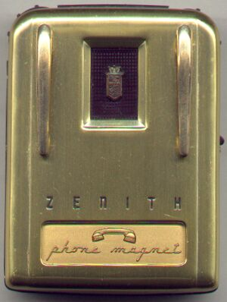
A hearing aid ! ….1953
Zenith Royal-T “Tubeless” hearing aid. 3” tall, 2.5” widexdftrd
A prehistoric iPod?

Slide 29
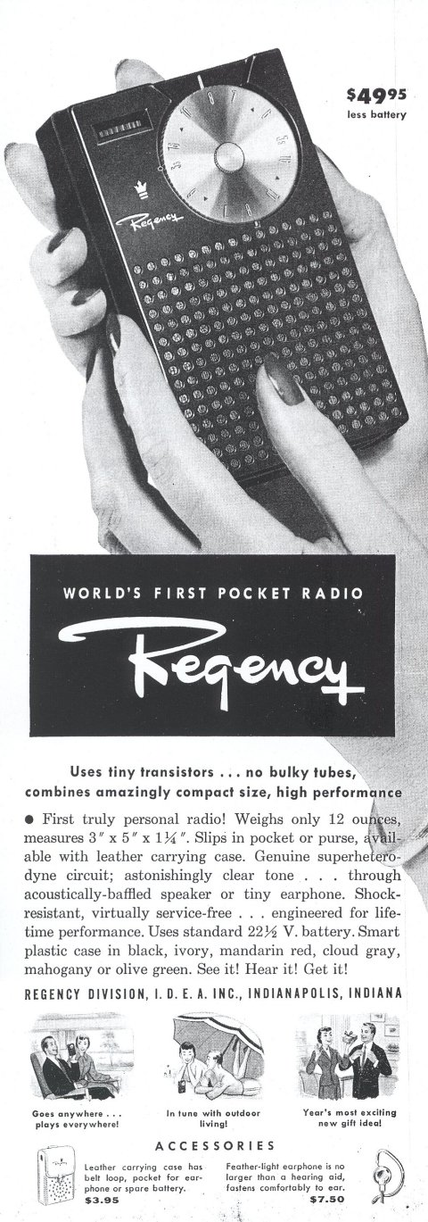
Followed immediately by the first “pocket radio” in 1954

Slide 30
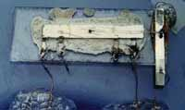
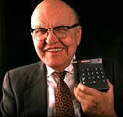
Jack Kilby - Invents the Integrated Circuit at Texas Instrument….1957
First commercial use of the IC was in a pocket calculator - 1961

Slide 31
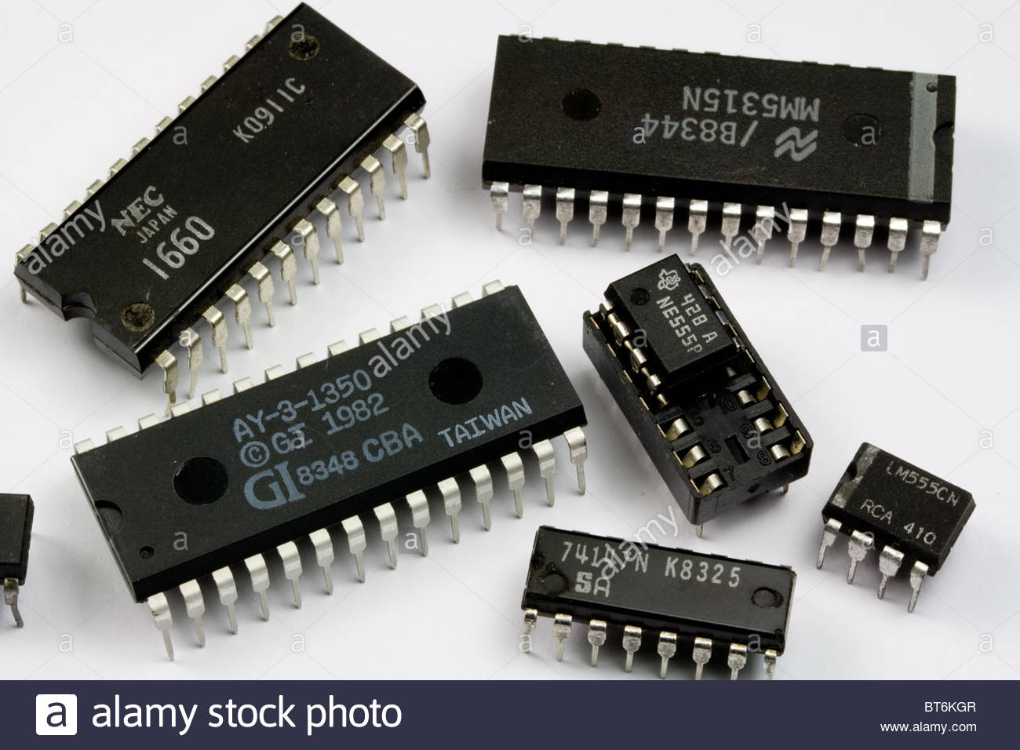
The Integrated Circuit (IC)
Enabled many transistors to be grouped into a single package
Lowered cost and decreased space compared to using individual transistors
Today exceeding 30 billion transistors in a single package of 4 square inches.
Still the building blocks for all modern electronics today

Slide 32
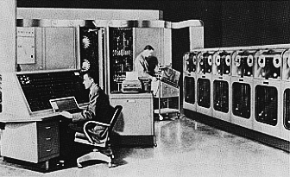
UNIVAC I
first commercial general-purpose computer system
delivered in 1951
used to forecast the 1952 presidential election

Slide 33
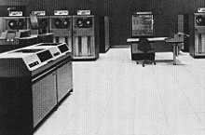
1960’s….IBM System/360
built using solid-state transistor circuitry
family of computer systems with backward compatibility
established the standard for mainframes for a decade
Used the “Timesharing” paradigm

Slide 34
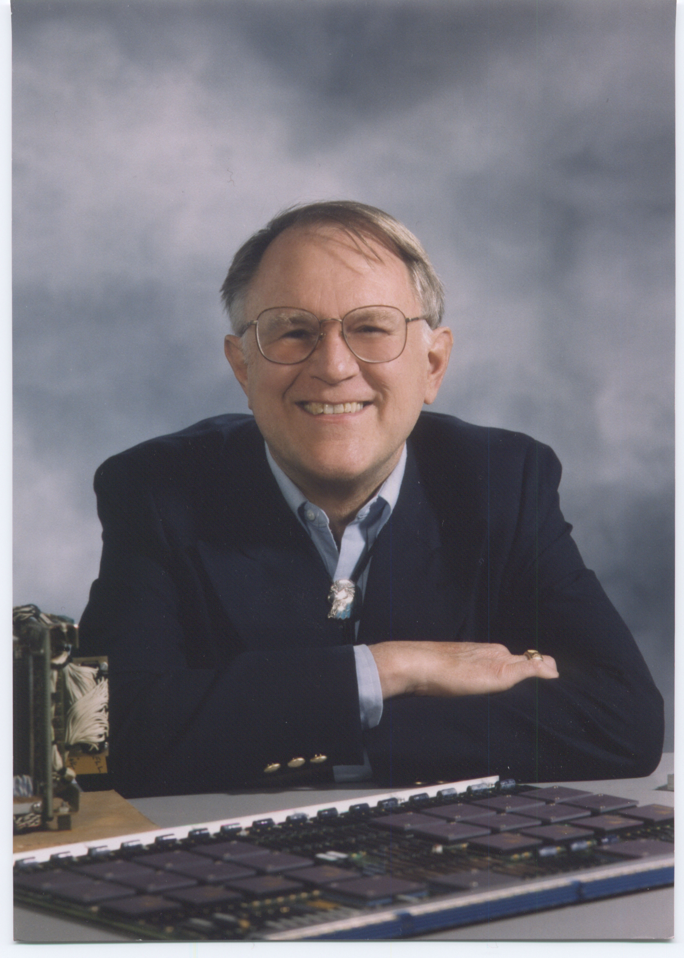
Gordon Bell, Father of the Minicomputer, Digital Equipment Corporation
Developed the first “Mini” computers 1960-83
Brought computing to small businesses
Created major competition for IBM, UNIVAC, who only built Mainframes at the time

Slide 35
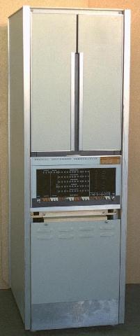
DEC PDP series
“minicomputers”
offered mainframe performance at a fraction of the cost
PDP-8 introduced at $20,000! Vs. >$1M for a Mainframe

Slide 36
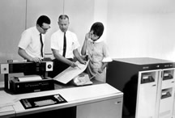
IBM fights back!
IBM 1130, built their own “small” computer, designed to compete with DEC’s minis

Slide 37
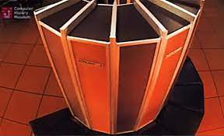
Specialized Supercomputers
First developed in the late 1970’s
high-performance systems used for scientific applications
advanced special purpose designs
Control Data Corporation, Cray Research, NEC, IBM and others
The Cray-1 Supercomputer - CHM Revolution
computerhistory.org
These Two Guys Tried to Rebuild a Cray Supercomputer - The Atlantic

Slide 38
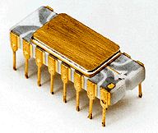
Intel 4004 Microprocessor - 1972
First commercially available micro-processor – first used in a programmable calculator
This technology made the personal computer possible
Contained 2300 transistors and ran at 100 khz

Slide 39
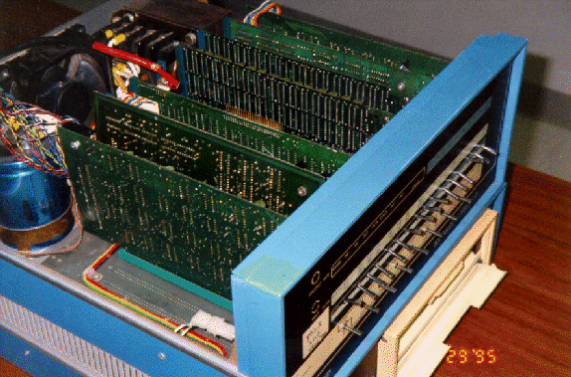
Altair 8080, the first kit micro computer…1975

Slide 40
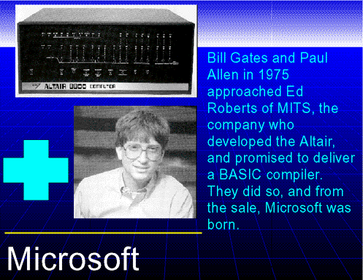

Slide 41
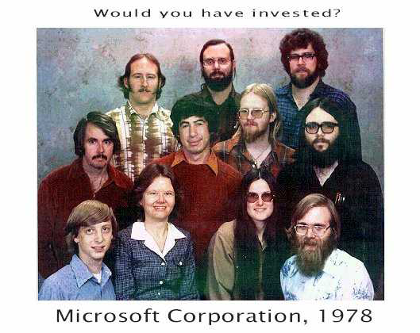

Slide 42
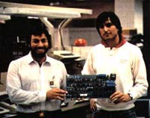
Developed in the family garage, Steve Wozniak and Steve Jobs with the first Apple I Computer in 1976. Sold for $666.66 - 200 were produced

Slide 43
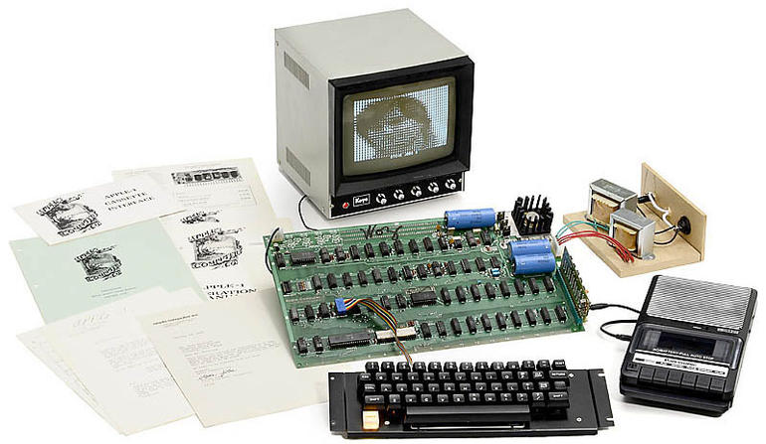
An original, unmodified Apple 1 computer brought over $300,000 at auction two years ago…

Slide 44
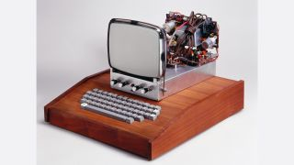
The Apple 1 computers were packaged by their owners in homemade enclosures.

Slide 45
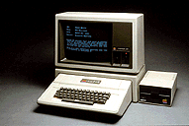
The Apple II - 1980
The first commercially available Apple
Initially sold to Wall St. bankers who wanted the Spread-sheet program called Visicalc which ran on the Apple II
Put Apple on the Map
Over 6 million produced through 1992!!

Slide 46
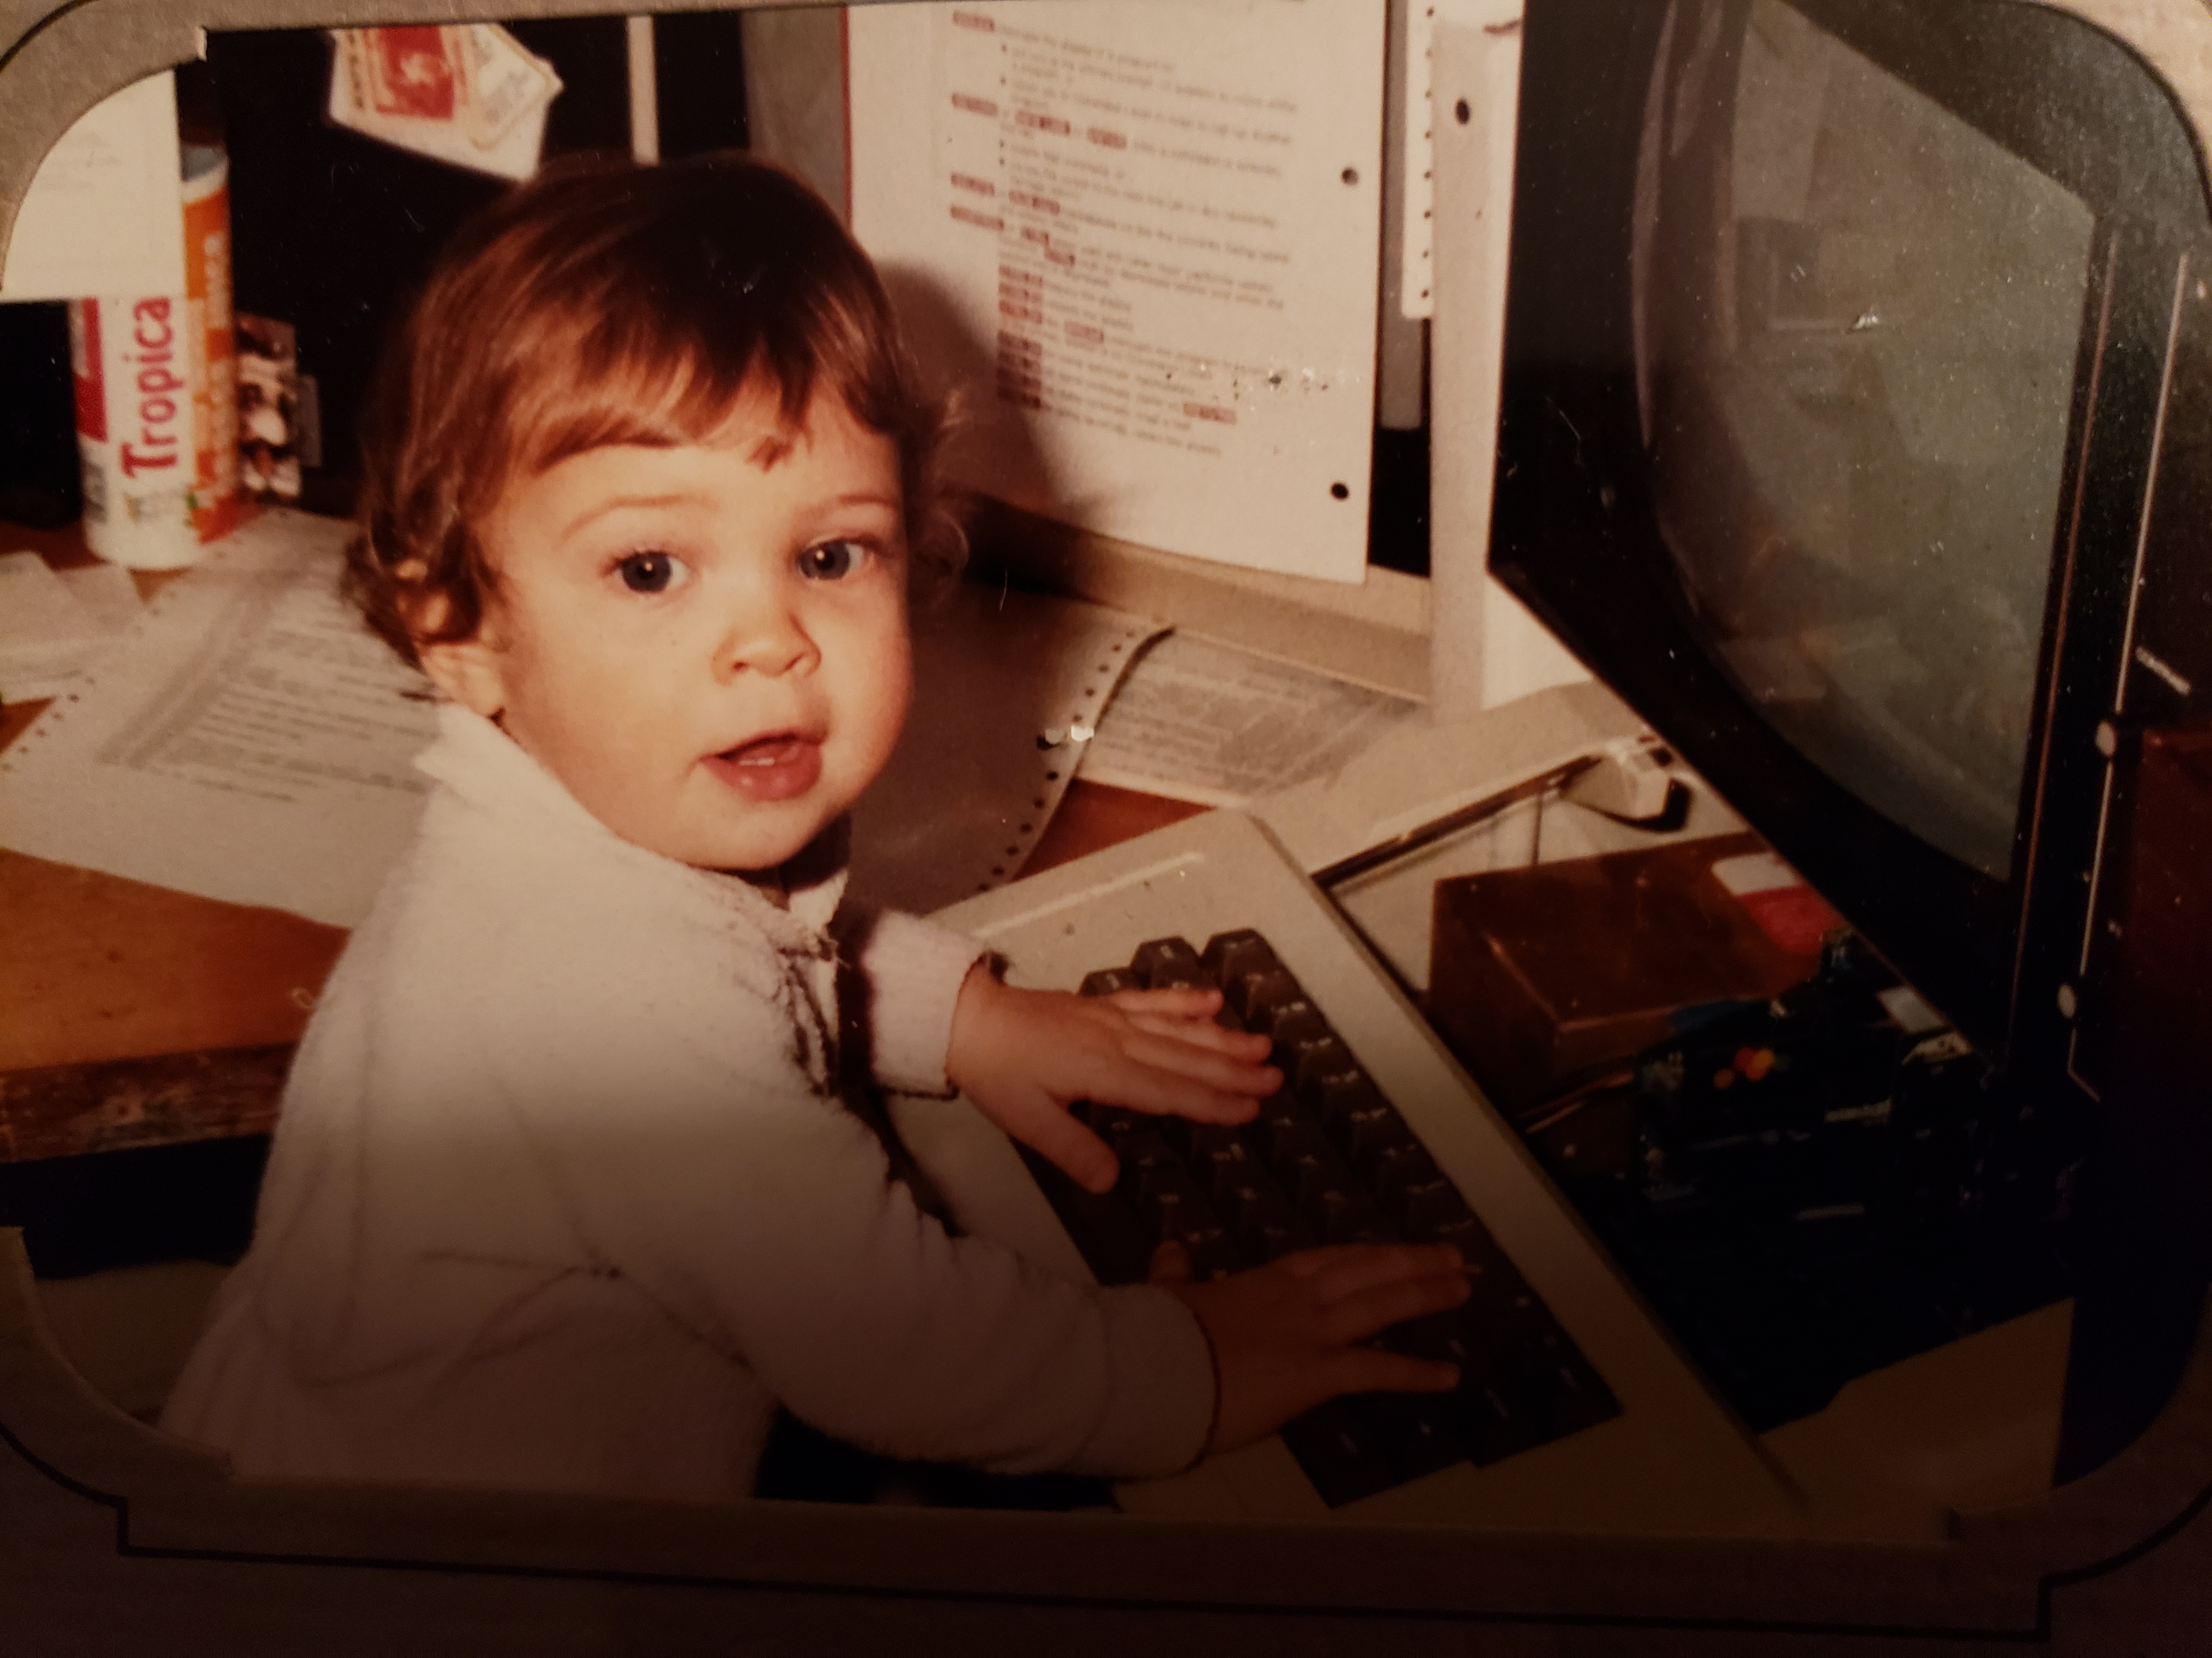
My daughter Amanda, programming my Apple II Computer at 18 months old! 1983

Slide 47
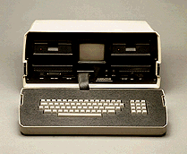
The Osborne 1 - 1981
The first “portable” personal computer
Came with lot’s of software bundled
Only weighed about 40 lbs and sold for $1795
Note the large 5” screen!

Slide 48
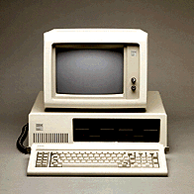
IBM PC - 1982
IBM’s first PC
Signaled a significant shift for the giant manufacturer
Established a new standard which is still being built on today
Operating system written by Bill Gates & Co. at Microsoft

Slide 49
The Computer Company that wasn’t, Xerox
Many of the innovations that became part of the Personal Computer scene were actually invented at XEROX Parc (Palo Alto Research Center)
Xerox was never able to successfully exploit those innovations that included the mouse, graphic user interface and the concept of WYSIWYG,
  (What you see is what you get)

Slide 50
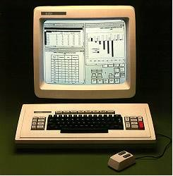
Xerox Star 1982

Slide 51
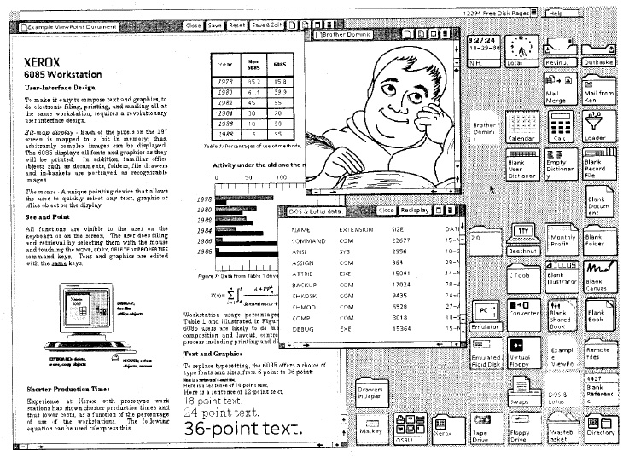
Xerox Star GUI

Slide 52

Apple MacIntosh - 1984
Second PC with GUI interface
Adopted from the work that was done at Xerox
Designed to be a computer appliance for “Real People”
Introduced at the 1984 Superbowl

Slide 53

The Graphic User Interface had arrived!

Slide 54
Video
MacIntosh 1984 Superbowl Ad
https://www.youtube.com/watch?v=VtvjbmoDx-I

Slide 55
1984 MacIntosh Ad
Directed by Ridley Scott
  (Alien, Blade Runner, Gladiator)
Cost $1.5M to make ( A record at the time)
Shown ONCE during ‘84 Superbowl at a cost of $500K
Considered to be the best TV ad ever!
Launched the Mac in grand style!

Slide 56
Just Some of the Companies that defined the Personal Computer Business early on
Xerox
IBM
Commodore
Texas Instrument
Osborne
MITS
AT&T
Compaq
Toshiba
Hitachi
Sinclair
Hewlett Packard
Sony
Apple
Microsoft
South West Technical Prod.

Slide 57

Moore’s Law
Moore’s law refers to an observation made by Intel co-founder Gordon Moore in 1965. He noticed that the number of transistors per square inch on integrated circuits had doubled every year since their invention. Moore’s law predicts that this trend will continue into the foreseeable future.”

Slide 58


Slide 59
Clock Frequency
Lead microprocessors frequency doubles every 2 years
10000
1000
2X every 2 years
100
P6
Pentium ® proc
Frequency (Mhz)
486
10
8085
386
8086
286
1
8080
8008
4004
0.1
1970
1980
1990
2000
2010
Year
Courtesy, Intel

Slide 60

Growth Speed of Key Technologies Obeys Moore’s Law

Slide 61
Today’s Price/Performance
Over 4 Billion operations per second costs less than $300
Memory is measured in Gigabytes….not Megabytes, Kilobytes
Storage is Terabytes, soon to be Petabytes
Communications speeds are measured in Megabits/Gigabits per second, not Kilobits
        And so it continues !!!

Slide 62
Impact of Moore’s Law
All of the personal computing devices that we use and enjoy today are a direct result of the ability year over year to reduce size, cost and energy consumption while at the same time increasing computer power.
The trend continues, but due to physics limitations Moore’s law is starting to slow down. We may have to consider changing the fundamental building blocks from silicon based transistors to another technology.
More on this in a future lecture

Slide 63

So…extremely small, powerful computers

Slide 64

and even smaller…..!!!!!

Slide 65

and….the very large! IBM Blue Gene
hydrodynamics, quantum chemistry, molecular dynamics, climate modeling and financial modeling

Slide 66


Slide 67
Web Resources for Computing History
http://www.computerhistory.org/timeline/
https://www.livescience.com/20718-computer-history.html

Slide 68
Questions?
Come up and touch the early
MAC!!!

